Slide 1
WP3 Mortality update
WP3 team: Judith Rankin, Svetlana Glinianaia (UNEW)
Anna Pierini, Michele Santoro and Alessio Coi (CNR-IFC)
Registry Leaders Meeting, 13th June 2018

Slide 2
WP3 Aim
To investigate survival of children born with congenital anomalies for the first 10 years of life and to evaluate prenatal diagnosis and other risk factors (sex, birth weight, gestation length, maternal age, parity, SES, non-European origin of the parents, geographical variation) for survival in Europe.

Slide 3
Update
Norway joined the WP3 participants in late 2017 - 21 participating registries
WP3 protocol for Ethics approval completed and placed on the EUROlinkCAT website together with the lay summary (Nov 2017)
All registries submitted their applications for Ethics/other approvals:
obtained – 11; ongoing – 10 (5 BINOCAR)
EUROCAT registry-specific case files ready for download (April 2018)
WP3 analysis plan (Excel spreadsheets and the descriptive Word document) completed (Mar 2018). Analysis plan updated in May 2018 by adding the modified grouping of causes of death, refined subgroups and description/tables for the analysis of geographic variation
Data linkage – progress differs by the registry (6 registers have started linkage process)

Slide 4
Update
Systematic review (not a project deliverable) – "Long-term survival of children born with congenital anomalies: a systematic review of population-based studies“ – registered with the PROSPERO database (Oct 2017), literature searches and papers selection ongoing

Slide 5
WP3 analysis plan
Aim
to provide each WP3 participating registry with the detailed stepwise instructions for the analyses of survival and the dummy tables for completion, and to facilitate the work of the WP2 team on the common syntax scripts which will guide the registries in their pre-specified local analyses

Slide 6
WP3 analysis plan
Kaplan-Meier survival analysis will be used for estimating survival up to age 10 years in children with congenital anomalies (by EUROCAT congenital anomaly subgroup and specific age group)

Slide 7
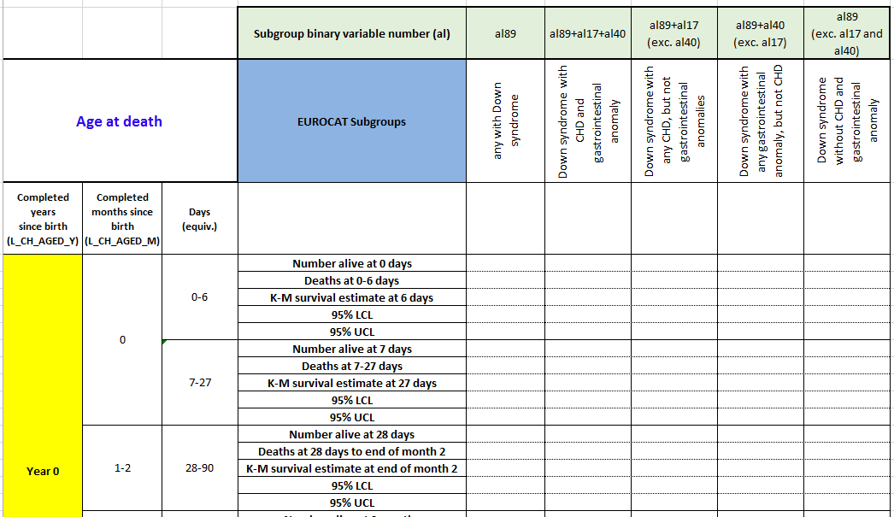
Kaplan-Meier survival analysis example – Down syndrome (Table 5C)

Slide 8
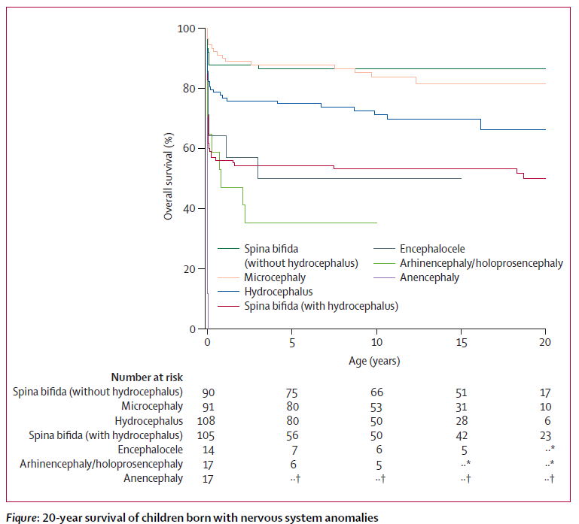
Kaplan-Meier Survival analysis – example of the survival curve (from Tennant et al, 2010, Lancet)

Slide 9
WP3 analysis plan
Kaplan-Meier survival analysis will be used for estimating survival up to age 10 years in children with congenital anomalies (by EUROCAT congenital anomaly subgroup and specific age group)
Cox proportional hazards regression - to explore the associations between the risk factors (e.g. prenatal diagnosis for infant deaths with four specific congenital anomalies, year of birth, maternal age, gestational age, SES variables) and the congenital anomaly subgroup-specific survival by age groups.

Slide 10
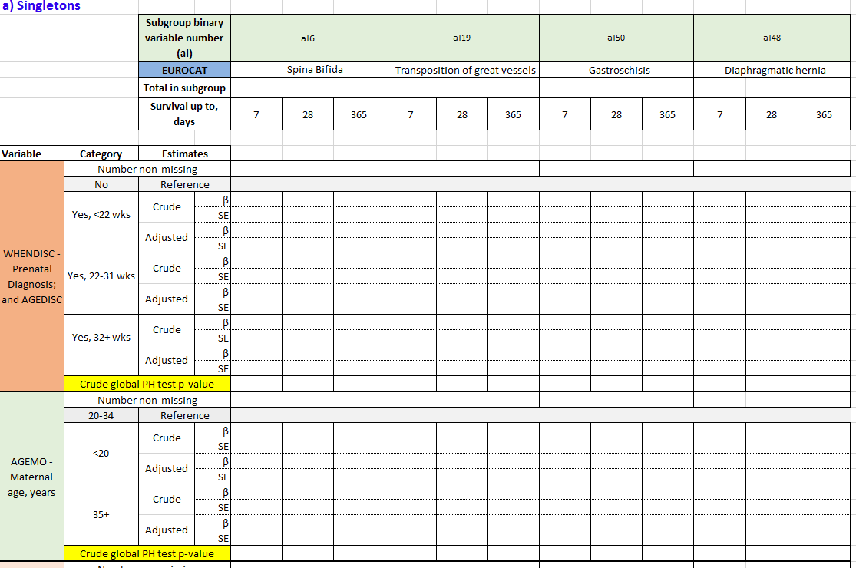
Cox proportional hazards regression
Model 1: the analysis of the effect of prenatal diagnosis on survival during the first year of life (four isolated anomalies only)

Slide 11
Cause of death
One of the WP3 tasks is to determine the contribution of congenital anomalies to mortality up to 10 years of age
Contribution of congenital anomalies to mortality based on the cause of death from death certificates
Evidence that an existing congenital anomaly is not commonly reported as an underlying cause on a death certificate (Copeland, 2007)
Decisions on cause of death groupings were clinically driven and also considered: small numbers, statistically relevant
Cause of death: <1 year, 1-9 years as different cause of death groupings
Notes:
One type of the tables in the analysis plan I’d like to focus on in more detail is ‘Cause of death’ tables where we had to suggest a grouping of major causes of death to avoid small numbers.
One of the WP3 tasks is to determine the contribution of congenital anomalies to mortality up to 10 years of age
An American study (Copeland and Kirby, 2007*) that compared mortality associated with a congenital anomaly using congenital anomaly registry data versus death certificate data, found that an existing congenital anomaly was not commonly reported as an underlying cause of death in a death certificate.
According to the ICD-10 guidance, the cause of death for primary tabulation should be designated the underlying cause of death.
As cause-of-death statistics are based on the underlying cause of death, in a death certificate of a child, in particular, infant death certificate, a congenital anomaly must be recorded as the Underlying cause of death or at least as a contributing cause of death.
The underlying cause of death is defined as the disease or injury which initiated the train of morbid events which led directly to death, or the circumstances of the accident or violence which produced the fatal injury - in accordance with the rules of the International Classification of Diseases (ICD, WHO) (excludes deaths at age under 28 days).

Slide 12
Next steps
Finalising Ethics approvals and other permissions for WP3
Linkage between the EUROCAT congenital anomaly data and mortality data
Assessment of the linkage quality and quality of the linked data
Writing registry-specific syntax scripts
Running local analyses for WP3 using the syntax scripts
WP3 Systematic review

Slide 13
Timeline for WP3
2017
2018
2019
2020
2021
Gantt Chart | Year 1 |  |  |  | Year 2 |  |  |  | Year 3 |  |  |  | Year 4 |  |  |  | Year 5
 | Q1 | Q2 | Q3 | Q4 | Q1 | Q2 | Q3 | Q4 | Q1 | Q2 | Q3 | Q4 | Q1 | Q2 | Q3 | Q4 | Q1 | Q2 | Q3 | Q4
WP3: Mortality associated with Congenital Anomalies
Develop protocols for registry ethical approval
Develop protocols for analysis
Analysis and writing of 2 peer review papers
Dissemination

