Slide 1
WP2: Overview of data linkage, data quality and the common data model
Maria Loane
Tuesday 12th June, 2018
Varese, Italy

Slide 2
Background
22 EUROCAT registries in 14 European countries will link their congenital anomaly (CA) data to mortality, hospital discharge, prescription and educational databases
Data on CAs are standardised across the EUROCAT network; information on mortality, morbidity and educational outcomes are not
Objectives:
To create a common data model that transforms key variables in local databases to standardised formats
To enable each registry to create a linked standardised dataset

Slide 3
1. Information in Congenital Anomaly (CA) case file (EDMP):
Information on baby & mother
Diagnosis (malformation codes)
Exposure
Family history
Sociodemographic
General comments
Notes:
Each registry has downloaded their congenital anomaly case file from the JRC. Confirm this with the attendees. Ask if anyone has not yet done this (exceptions are Finland, Norway and Odense)

Slide 4
Baseline information on registry CA data
Baseline tables produced showing
Number pf cases in each CA subgroup, by type of birth and year of birth (A6 tables)
Number of cases in the 27 additional subgroups to be analysed in this project, by type of birth, year of birth (A6 User-defined tables)
Frequency/ crosstab tables produced for key study variables
The purpose of the above tables is NOT to judge registries, but to provide baseline information required to correctly interpret the results
Notes:
The A6 User-defined tables were only created for the first 10 additional subgroups.

Slide 5
Data linkage

Slide 6
What is Data Linkage?
“Data linkage connects information stored in different databases/ locations that relate to the same individual
In some European regions, CA data are only held in the registry i.e. they are not stored in regional/ national governmental statistics departments
EUROlinkCAT involves linking a cohort of congenital anomaly(CA) cases to:
Mortality/ Deaths (WP3)
Morbidity – Hospital records (WP4 and WP6)
Prescriptions (WP4)
Education (WP5)

Slide 7
How are CA cases linked to external databases?
Key variables present in each file to be linked such as:
Unique ID number (for example, Health & Social Care Number)
Date of birth (this information is required for linkage purposes only)
Number of babies (EUROCAT variable used to denote multiple births)
Type of birth (N.B. Use variable “type” for local registry definition)
Some “linkage” variables may relate to the mother, rather than the child
Maternal date of birth
If include variables relating to socio-economic status ,then need to link to maternal ID also.

Slide 8
Example of congenital anomaly case file
centre | byear | nunloc | birth_ type | sex
99 | 2018 | 001 | 1 | 1
99 | 2018 | 002 | 1 | 2
99 | 2018 | 003 | 1 | 1
99 | 2018 | 004 | 1 | 2
99 | 2018 | 005 | 1 | 2
99 | 2018 | 006 | 1 | 1
99 | 2018 | 007 | 1 | 1
99 | 2018 | 008 | 1 | 1
99 | 2018 | 009 | 1 | 2
99 | 2018 | 010 | 1 | 1
99 | 2018 | 011 | 1 | 2
99 | 2018 | 012 | 1 | 2
99 | 2018 | 013 | 1 | 2
99 | 2018 | 014 | 1 | 2
99 | 2018 | 015 | 1 | 1
The EUROCAT numloc variable (ID number) is not always the true ID number of the child
May have to merge your CA case file with registry file holding the baby’s unique health & care number (or European equivalent), or name & address

Slide 9
Archive a copy of your CA case file locally. This file will be used for all linkage studies
Two options for linkage:
The registry is linking the CA case file to local databases
An external person/ organisation will link the CA case file to local databases
End result is a linked case file

Slide 10
Following linkage, next steps:
Provide a short report on the linkage process
For each dataset, how many cases were linked?
How many cases were unlinked, with the reason?
The linked file remains with the local Data Provider/ Institutions – it is not sent to UU
You will receive instructions (syntax script) on how to produce frequency tables (by year) for all the variables in the linked file
Send these frequency tables to UU (including missing values) so that data quality can be assessed
If data quality ok, you will be provided with another syntax script to produce tables/ Odds Ratios (data analysis) for inclusion in the Central Results Repository.

Slide 11
Data validation/ quality assurance

Slide 12
Data validation checks in EDMP
Completeness – may vary over time
Conforms to data format (string, numeric, date), variable length (number of characters), pre-defined values (range of valid codes)
Logical validation – describing the relationship between variables e.g.
If type of birth =2, 3 or 4 (SB/ SA/ or TOPFA), then SURVIVAL must be 2 (No);
If type of birth =4 (TOPFA), then WHENDISC must be 6 (prenatal)
If survival beyond a week of age =1 (yes), then TYPE =1 (livebirth).

Slide 13
Data validation checks of linked data
All linked variables are prefixed with L_ to differentiate these from EUROCAT variables
Completeness – may vary over time
Conforms to data format as per the data dictionary sent by the registries last year
Logical validation – describing the relationship between variables e.g.
Date of death should not come before date of birth
There can only be one date of death
Frequency distributions, and trends over time (by year of birth)
Crosstab tables
Notes:
Some variables will be in both the EIROCAT CA case file and the linked file with data from local databases. In addition, some may have similar variable names
If discrepancies in values between 2 files, the CA case file will be taken as correct for EUROCAT core variables. Date of death information on death certificates will be taken as correct if this differs from EUROCAT case file

Slide 14
Check: Linked v Non-linked data by year of birth
 | Linked | Not linked | Total
2005 | 0 | 1000 | 1000
2006 | 0 | 1050 | 1000
2007 | 400 | 600 | 1000
2008 | 930 | 70 | 1000
2009 | 950 | 50 | 1000
2010 | 990 | 10 | 1000
2011 | 1000 | 0 | 1000
2012 | 995 | 5 | 1000

Slide 15
Data Checking
If numbers are not as expected based on
Archived Congenital Anomaly case file
Frequency tables based on external databases (e.g. the Mortality database)
Other European sources such as EUROPERISTAT infant mortality rates
Check with the data provider that:
Duplicates have been removed
The external database is in the correct structure i.e. one row per case (for mortality)
Double counting has not occurred i.e. cases coded with ICD9 and ICD10 codes counted twice
Cases have unique ID

Slide 16
Standardisation

Slide 17
Notes:
Registries transmit congenital anomaly data using EDMP program. This ensures that all files have the same variable names which means that case data can be imported into central database .
In the 1970s, it took 5 years to agree the congenital anomaly variables and standardise the coding across EUROCAT

Slide 19
Centre | Variable name | Existing code values
Basque Country | SEXO | 1=Male; 6=Female
Malta | gender | M=male, F=female
Odense | C_SEX | Maend = male, Kvinder = female
Wales | DEC_SEX_CD | 1 =Male, 2 =Female
Valencia Region | SEXO | Number: 1=male, 6= female
Ukraine | CH_SEX | 1 = Male; 2 = Female; 3 = Undetermined
Saxony Anhalt | EF306 | 1= male; 2= female
Zagreb | GENDER | M/1 = Male; F/2 = Female
Paris | SexeDefunt | 1=masculin, 2=féminin
N Netherlands | geslacht | 1= male, 2= female
Antwerp | SEX | 1 Male, 2 Female, 3 Not known
Emilia Romagna | SEX / SEX | M = Male, F = Female
Finland | KVUOSI | 1 Male, 2 Female
Binocar | sex | 1 = Male, 2 = Female, 9 = Not specified 0 = Not known
Norway | KJONN | 1 = Boy, 2 = Girl, 3 = Information missing
Isle de Reunion | SexeDefunt | 1=masculin, 2=féminin
Tuscany | SESSO | 1=M, 2= F
Notes:
Compare with information recorded in mortality databases across Europe using a simple example – gender. Notice different variable names, different values, different formats.

Slide 20
Standardise linked datasets across registries
Standardise variable names
L_CH_SEX
Standardise the variable definition (e.g. medication prescribed is not the same as medication dispensed)
Sex of infant
Standardise variable structure/ format / type, integer, string
Integer
Standardise values
1=male, 2=female
Local variables remain unchanged i.e. a new variable is created that transforms the local variables to the EUROlinkCAT definition
Notes:
Methodology – only briefly touch on this – how to select population controls if not using whole population…

Slide 21
Summary of overall process

Slide 22
Final steps
Secure portal created for data transfer (i.e. tables, crosstabs, Odds Ratio estimates etc generated from lined data file)
Each registry will have own log-in details to upload data to secure portal
Registry data will downloaded from portal and imported into Central Results Repository (CRR)
Data for all registries will be pooled and sent to WP leader for meta-analysis

Slide 23
Clear documentation for each step in the process
Need for data dictionaries
Audit trail – repeatable, reproducible
Local knowledge of the data is essential for accuracy and correct interpretation
Notes:
Give example that registry sent frequencies on proxy SES variable for 80% of population, but locally it is known that this info is available for 98% of population. Need to check linkage….

Slide 24
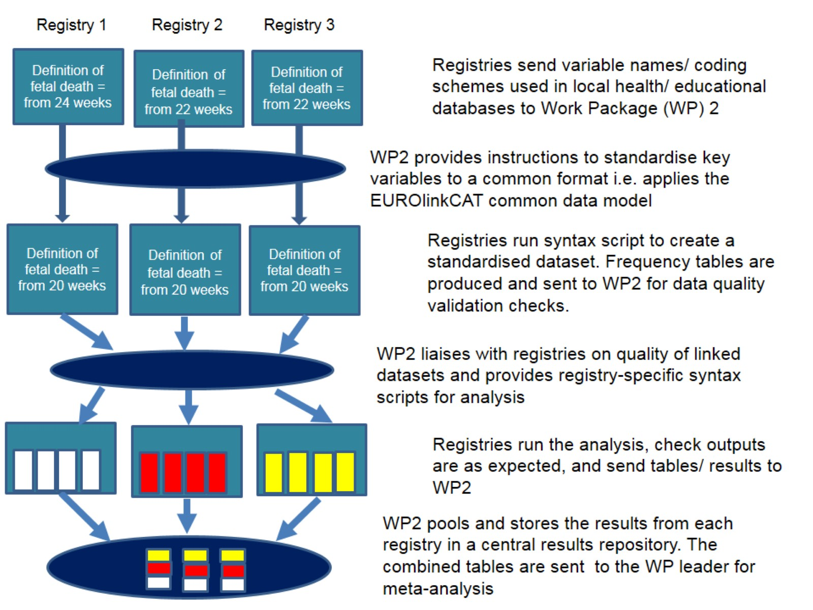
Notes:
We recognise that registries/ local data providers know their data better than us, so local registries can standardise their variables to the EUROlinkCAT format
Joachim will discuss syntax scripts etc…

Slide 25
Thank you!

Slide 26
Geographical variation in prevalence of all congenital anomalies, 1995-2014

