Slide 1
WP3 – Mortality associated with congenital anomalies
WP3 team: Judith Rankin, Svetlana Glinianaia (UNEW)
Anna Pierini, Michele Santoro and Alessio Coi (CNR-IFC)
EUROlinkCAT meeting 12th June 2018

Slide 2
Update
Norway joined the WP3 participants later in 2017 which resulted in 21 participating registries
WP3 protocol for Ethics approval completed and placed on the EUROlinkCAT website together with the lay summary (Nov 2017)
All registries submitted their applications for Ethics/other approvals:
obtained – 11; ongoing – 10 (5 BINOCAR)
EUROCAT registry-specific case files ready for download (April 2018)
WP3 analysis plan (Excel spreadsheets and the descriptive Word document) completed (Mar 2018)
Analysis plan updated in May 2018 by adding the modified grouping of causes of death (Tables 4), codes for the new subgroups and tables/description for the analysis of geographic variation
Data linkage – progress differs by the registry
Systematic review (not a project deliverable) – "Long-term survival of children born with congenital anomalies: a systematic review of population-based studies“ – registered with the PROSPERO database (Oct 2017), literature searches and papers selection ongoing
Notes:
Norway joined the WP3 participants later in 2017 resulting in 21 participating registries
WP3 protocol for Ethics approval completed and placed on the EUROlinkCAT website together with the lay summary (Nov 2017)
All registries submitted their applications for Ethics/other approvals:
obtained – 10; ongoing – 11 (5 BINOCAR)
Depending on the local situation, all registries submitted either their applications for Ethics approval for data linkage or other permissions (e.g. to access linked data - Finland, Denmark and Norway).
10 registries have already obtained permissions (e.g. BINOCAR received REC and CARG approvals) for data linkage and 6 have started the data linkage (Italy: ER, Italy: Tuscany, Malta, Spain: Valencia, Wales, Ukraine), other registries are awaiting other permissions (e.g. BINOCAR - GDPR, Denmark – Statistics Denmark, Antwerp – Privacy commission) and among them, three - NNL, Spain: Basque estimate to start data linkage in June and Denmark anticipates to obtain linked data in June.
EUROCAT registry-specific case files ready for download
WP3 analysis plan (Excel spreadsheets and the descriptive Word document) completed in Mar 2018
Updated in May 2018 by adding the modified grouping of causes of death (Tables 4), codes for the new subgroups and tables for the geographical analysis
Data linkage – progress differs by the registry
Systematic review (not a project deliverable) – "Long-term survival of children born with congenital anomalies: a systematic review of population-based studies“ – registered with the PROSPERO database (Oct 2017), literature searches and papers selection ongoing

Slide 3
WP3 analysis plan
Aim
to provide each WP3 participating registry with the detailed stepwise instructions for the analyses of survival and the dummy tables for completion, and to facilitate the work of the WP2 team on the common syntax scripts which will guide the registries in their pre-specified local analyses

Slide 4
WP3 analysis plan
WP3 team (stage 2)
Word file - describes the study subjects and the main principles of the analyses, and lists the Excel tables
The Excel file - contains the detailed tables (n=40) in 24 spreadsheets:
T 1-T 4 – cross-tabulations, including cause of death groups
T 5A-T 5G – Kaplan-Meier Survival analysis
T 6A-T 6G – Cox proportional hazards regression
T 7A-T 7B – Population Mortality
T 8A-T8C – Risk factors distribution and adjusted survival analysis
Notes:
Stage 1 – WP2 team
EUROCAT tables and data quality checking for each registry
Frequency tables for mortality data – each registry
Summary of registry-specific linkage details
Assessment of quality of data linkage and linked data
After the first five spreadsheets with descriptive tables, including two spreadsheets with causes of death by child’s age (T 4A - infant - and T 4B – 1-9 years), seven spreadsheets with the K-M survival analysis and further seven ones with the Cox regression are given.

Slide 5
Kaplan-Meier Survival analysis
‘T 5 – Survival analysis’ (T 5A –T 5G)
T 5A – for live births with an isolated anomaly (coded as N, A, R and I in 'mult_malf' EDMP derived variable: N: NTD isolated; A: isolated cardiac; R: isolated renal; I: isolated other) by a selected congenital anomaly subgroup
Singletons;
All linked live births (singletons and multiples)
T 5B – for all structural anomalies (select isolated cases using A, N, R and I 'mult_malf' codes and potential multiple anomalies using 'M' code).
T 5C – All linked live births - Down syndrome
T 5D – All linked live births - Genetic syndromes and other rare congenital anomalies
T 5E, T 5F, T 5G - survival analysis by subgroups of congenital anomalies and by time period (1995-2004 and 2005-2014) for three different groups of congenital anomalies:
T 5E: isolated anomalies,
T 5F: all structural anomalies
T 5G: Down syndrome with or without additional anomalies
Notes:
Seven tables are devoted to the K-M survival analyses, the tables differ by the child’s age at death and by the EUROCAT CA subgroups – e.g. isolated anomalies, all structural anomalies, Down syndrome, rare genetic and structural anomalies.
Groups for age at death to be used for the K-M survival analyses:
0-6 days of age, 7-27 days, 1-2 months (28-90 days), 3-5 months (91-182 days), 6-11 months (183-364 days), and then for each year after the first year of life up to 10 years (see Excel tables T 5A-T C). For T 5D – after the first year, the years are combined to 1-4 years and 5-9 years.

Slide 6
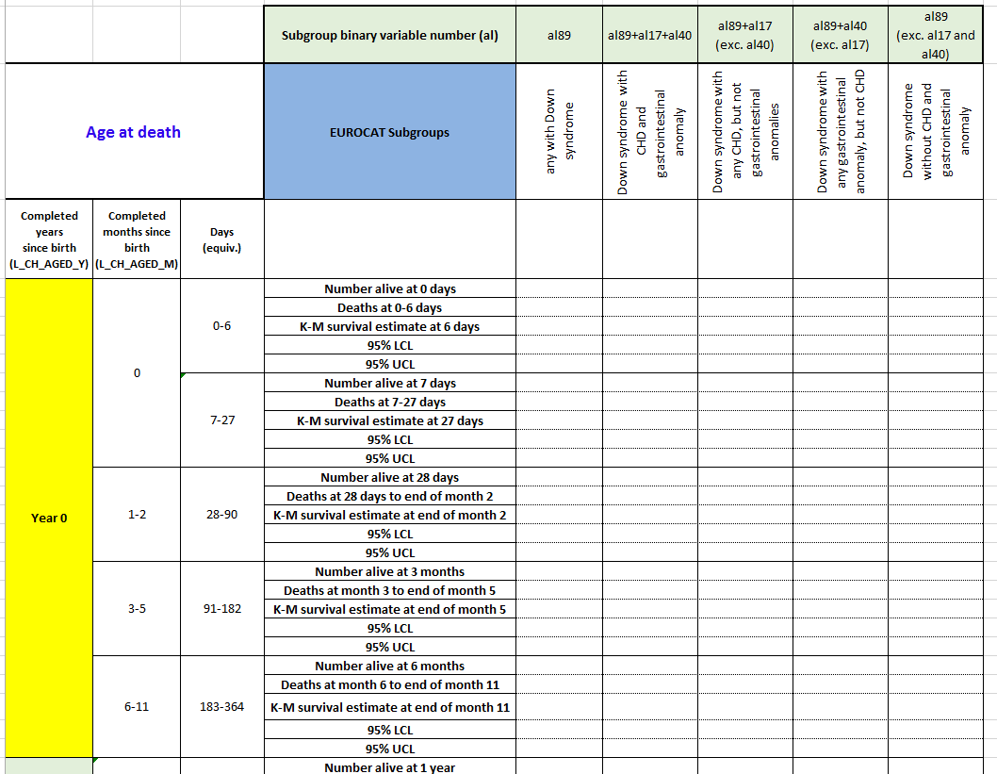
Kaplan-Meier survival analysis – Down syndrome
Notes:
An example given: Kaplan-Meier Survival analysis up to 10 years of age by subgroups of congenital anomalies
All linked live births (singletons and multiples) - Down syndrome
Subjects at risk for each age group, number of deaths, K-M survival estimates (% with 95% CI) will be provided.
Surviving children with congenital anomalies should be censored at their 10th birthday or at 31 Dec 2015 if the follow-up was shorter than 10 years, or if they have migrated outside the study area before the end of follow-up.
Select those with Down syndrome and categorise:
any with Down syndrome (al89 - no exclusions)
b) Down syndrome with CHD and gastrointestinal anomaly (al89 + al17 +al40)
c) Down syndrome with CHD (al89 + any CHD (al17) but not with gastrointestinal anomaly (exclude those with al40);
d) Down syndrome with gastrointestinal anomaly (al89 +al40) and not with CHD (exclude those with al17);
f) Down syndrome with neither CHD nor gastrointestinal anomaly (exclude those with codes al17 and al40);

Slide 7
Cox proportional hazards regression
T 6A-T 6G spreadsheets
T 6A - Model 1: the analysis of the effect of prenatal diagnosis on survival during the first year of life (isolated anomalies only including those with 'mult_malf' codes N, A, I) - for cases of isolated spina bifida, transposition of great arteries, diaphragmatic hernia and gastroschisis (al6, al19, al48 and al50)
T 6B - Model 2: the analysis of the effect of other risk factors on survival up to 365 days - isolated anomalies only
T 6C - Model 3: the analysis of the effect of other risk factors on survival up to 365 days - include all structural anomalies
T 6D: Model 4: the analysis of the effect of other risk factors on survival up to 365 days - Down syndrome with or without additional anomalies
T 6E: Model 5: the analysis of the effect of the risk factors on survival during 1-9 years of age - include all cases with isolated anomalies (N, A, R and I codes only)
T 6F: Model 6: the analysis of the effect of the risk factors on survival during 1-9 years of age - include all structural anomalies (A, N, R, I and 'M' code)
T 6G: Model 7: the analysis of the effect of the risk factors on survival during 1-9 years of age - Down syndrome with or without additional anomalies
Notes:
Survival analysis to explore the associations between the risk factors (e.g. prenatal diagnosis for infant deaths with four specific congenital anomalies, year of birth, maternal age, gestational age, SES variables) and the congenital anomaly subgroup-specific survival by age groups will be run using Cox proportional hazards regression.
T 6A-T 6G spreadsheets for seven models differing by age groups or congenital anomaly subgroups included

Slide 8
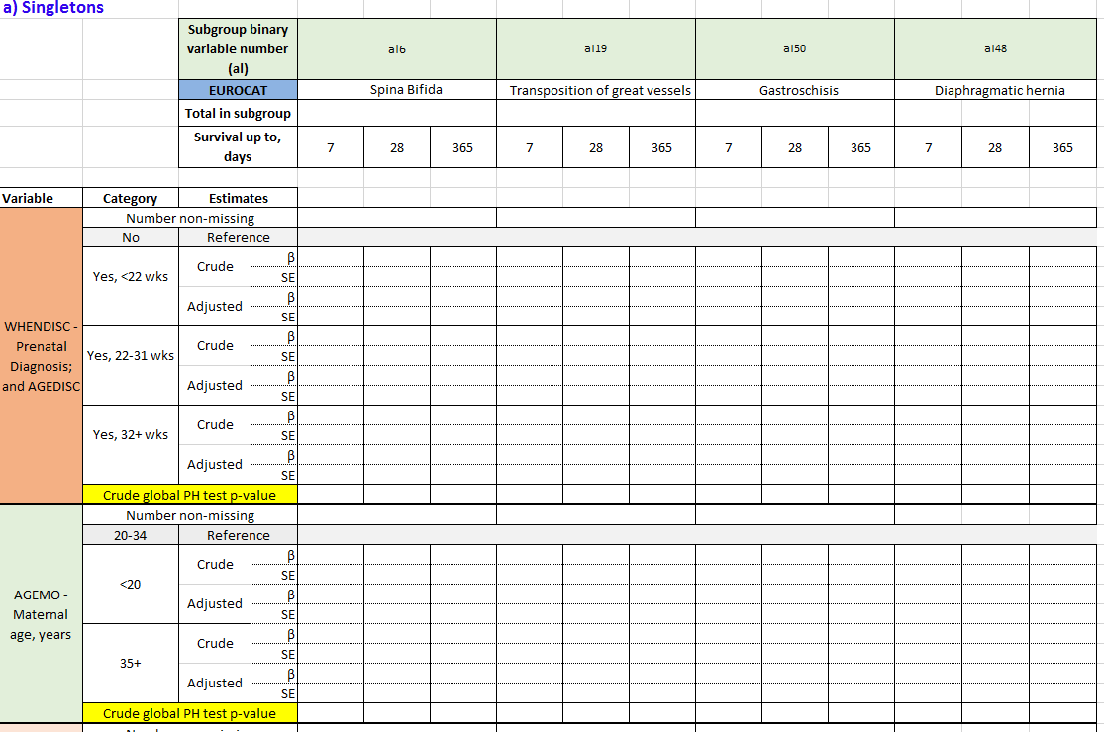
Cox proportional hazards regression
Model 1: the analysis of the effect of prenatal diagnosis on survival during the first year of life (four isolated anomalies only)
Notes:
Seven spreadsheets cover the Cox regression analysis for different child age groups and various types of congenital anomaly subgroups.
For all T 6 tables, the unadjusted and adjusted models will be run for each of the agreed risk factors (except for ‘prenatal diagnosis’ which relates to T 6A only) reporting crude β coefficients with the standard errors and the adjusted β coefficients with the standard errors respectively.
Crude global proportional hazards (PH) test p-value will be reported for each unadjusted analysis and adjusted model global PH test (p-value) will be reported for the adjusted models for each outcome and anomaly.
Definition: Schoenfeld Residuals Test
The Schoenfeld Residuals Test is used to test the independence between residuals and time and hence is used to test the proportional Hazard assumption in Cox Model.
One of key assumptions in the Cox Proportional Hazard model is that of proportional hazards. According to proportional hazard condition, the covariates are multiplicatively related to the hazard i.e. in a regression type setting the survival distributions should have hazard functions that are proportional over time. In simple words hazard for any individual is a fixed proportion of hazard for any other individual.
The Schoenfeld Residuals Test is analogous to testing whether the slope of scaled residuals on time is zero or not. If the slope is not zero then the proportional hazard assumption has been violated. In this test, there is separate residual for each individual for each covariate, and the covariate value for individuals that failed minus its expected value is defined as Schoenfeld residuals. If the plot of Schoenfeld residuals against time shows a non-random pattern, the PH assumption has been violated. The residuals can be regressed against time to further test independence between residuals and time.

Slide 9
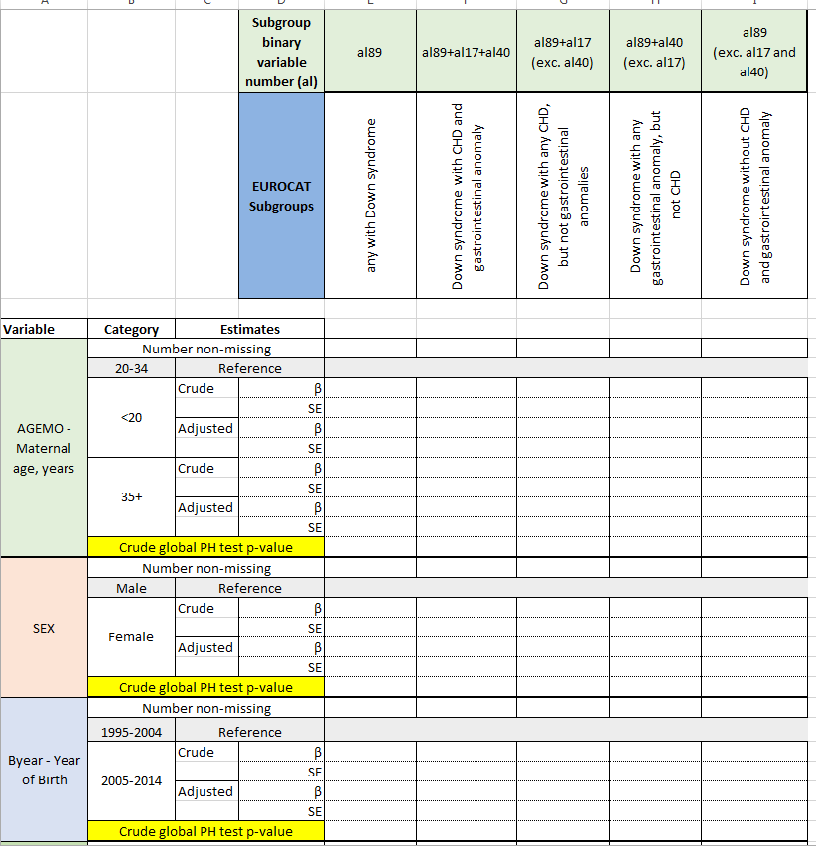
Cox proportional hazards regression
Model 4: the analysis of the effect of the listed risk factors on survival up to 365 days - Down syndrome with or without additional anomalies

Slide 10
Cause of death
One of the WP3 tasks is to determine the contribution of congenital anomalies to mortality up to 10 years of age
an existing congenital anomaly is not commonly reported as an underlying cause on a death certificate (Copeland, 2007)
Consider comparison between the EUROCAT congenital anomalies in the mortality cases and those recorded on a death certificate
ICD-10: the cause of death for primary tabulation should be designated the underlying cause of death
Definition
The underlying cause of death is defined as (a) the disease or injury which initiated the train of morbid events which led directly to death, or (b) the circumstances of the accident or violence which produced the fatal injury
Notes:
One type of the tables in the analysis plan I’d like to focus on in more detail is ‘Cause of death’ tables where we had to propose a grouping of major causes of death to avoid small numbers.
One of the WP3 tasks is to determine the contribution of congenital anomalies to mortality up to 10 years of age
An American study (Copeland and Kirby, 2007*) that compared mortality associated with a congenital anomaly using congenital anomaly registry data versus death certificate data, found that an existing congenital anomaly was not commonly reported as an underlying cause of death in a death certificate.
*Copeland GE, Kirby RS. Using birth defects registry data to evaluate infant and childhood mortality associated with birth defects: an alternative to traditional mortality assessment using underlying cause of death statistics. Birth Defects Res A Clin Mol Teratol 2007; 79: 792-797.
According to the ICD-10 guidance, the cause of death for primary tabulation should be designated the underlying cause of death.
As cause-of-death statistics are based on the underlying cause of death, in a death certificate of a child, in particular, infant death certificate, a congenital anomaly must be recorded as the Underlying cause of death or at least as a contributing cause of death.
The underlying cause of death is defined as (a) the disease or injury which initiated the train of morbid events which led directly to death, or (b) the circumstances of the accident or violence which produced the fatal injury
4.1 Coding instructions for mortality: underlying cause of death (ICD-10 vol 2 – manual)
It was agreed by the Sixth Decennial International Revision Conference (28) that the cause of death for primary tabulation should be designated the underlying cause of death.
The cause of death is defined as the disease or injury which initiated the train (sequence) of morbid (disease-related) events which led directly to death, or the circumstances of the accident or violence which produced the fatal injury (ICD, WHO).
28. Report of the international conference for the sixth decennial revision of the international lists of diseases and causes of death. In: Official records of the World Health Organization. No. 11. Report of expert committees and other advisory bodies to the Interim Commission. New York and Geneva: United Nations and World Health Organization; 1948:23–32 (http://whqlibdoc.who.int/hist/official_records/11e.pdf, accessed 24 May 2014).
The international mortality coding instructions presuppose that data have been collected with a death certificate conforming to the International form of medical certificate of cause of death (see Annex 7.1). Otherwise, the causes of
death cannot be coded according to the international standard and the data will not be internationally comparable.
4.2 Coding instructions for mortality:
selecting the underlying cause of death
When coding and classifying causes of death, you must first assign ICD codes to all the conditions mentioned on the death certificate. Many coding instructions are based on specific ICD codes and, to determine whether any of the instructions apply, you need to know the ICD codes for all conditions on the certificate. This is called multiple-cause coding (see section 4.3, Coding instructions for mortality: multiple causes). Next, you select an underlying cause of death to be used in the mortality statistics. This is called classification of the underlying cause of death.

Slide 11
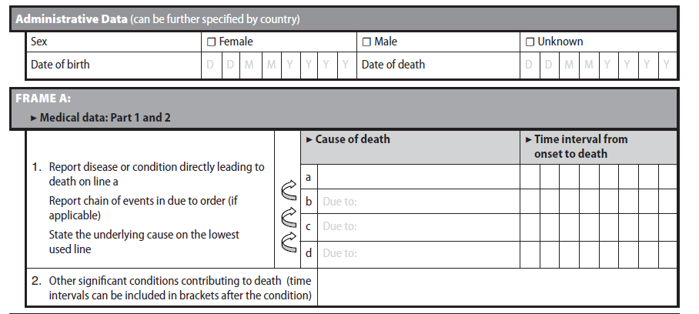
International form of medical certificate of cause of death – ICD-10
Notes:
Part I: Lines 1-4
Causes of death are entered sequentially starting with immediate cause and ending with the underlying cause
Part I: Enter the chain of events - - diseases, injuries, or complications - - that directly caused the death. DO NOT enter terminal events such as cardiac arrest, respiratory arrest, or ventricular fibrillation without showing the etiology. DO NOT ABBREVIATE. Enter only one cause on a line. Add additional lines if necessary.
IMMEDIATE CAUSE (Final disease or condition resulting in death)
Sequentially list conditions, if any, leading to the cause listed on line a. Enter the UNDERLYING CAUSE (disease or injury that initiated the events resulting in death) LAST
It is important to identify the underlying cause of death which should be used in death statistics.
There are Automated Coding Systems for producing underlying cause of death: Software for capturing medical terms on death certificate, Software for converting text of medical terms into ICD codes (SuperMICAR) and Software for applying ICD’s Selection & Modification rules to select underlying cause (ACME: Automated Classification of Medical Entities (underlying cause output).
TRANSAX: Translation of Axes (multiple cause output)
General principle:
When more than one condition is entered on the certificate, select the condition entered alone in the lowest-used line of Part I only if it could have given rise to all the conditions entered above it.
PART II. other significant conditions contributing to death

Slide 12
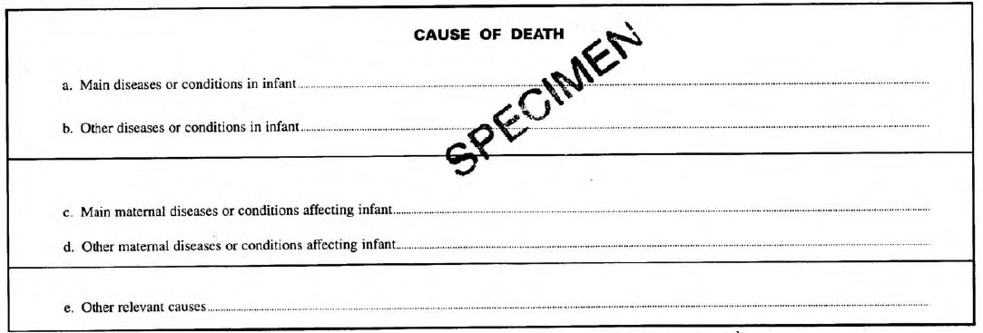
Cause of neonatal death
Notes:
The neonatal and stillbirth certificates introduced in England &Wales January 1986 follow recommendations of WHO in the ICD, whereby causes of death are given separately in the following categories:
main diseases or conditions in infant or fetus
other diseases or conditions in infant or fetus
main maternal diseases or conditions affecting infant or fetus
other maternal diseases or conditions affecting infant or fetus
other relevant causes

Slide 13
Availability of cause of death variables
Variable | Antwerp | BasqueCountry | BINOCAR | Denmark | EmiliaRomagna | Finland | Malta | NNetherlands | Paris | Reunion | Saxony-Anhalt | Tuscany | Ukraine | Valencia | Wales | Zagreb
Cause of death text - IA |  |  | y | y |  |  |  |  | y | y
Cause of death text - B |  |  | y | y
Cause of death text - C |  |  | y | y
Cause of death, first 3 digits ICD9/ ICD10 |  | y
Cause of death, 4th digit ICD9/ ICD10 |  | y |  |  | y |  |  |  | y | y |  | y
Cause of death text -II |  |  | y | y
Cause of death text |  |  | y
Underlying cause - ICD9/ ICD10 | y |  | y | y |  | y | y | y | y | y | y | y | y | y | y | y
Any multiple cause code – ICD9 or ICD10, where provided |  |  | y | y |  |  | y | y |  |  | y |  |  | y | y
Notes:
We need the underlying cause of death for our statistics and analysis – the majority of participants have the underlying cause of death available and a number of registries will also be able to provide other causes of death. If a single cause of death is provided (ER or Basque Country) we expect this to be the underlying cause of death.
Will ned to develop an algorithm for grouping an underlying cause of death into the WP3 major groups and also for grouping other causes of death (multiple, contributory).
In the linked cases of death when there is no congenital anomaly recorded as an underlying cause of death and there are other causes of death provided, we will need an algorithm for picking up a congenital anomaly from other causes if a congenital anomaly is present in any of them.
Multiple causes: causes of death including not only the underlying cause but also immediate cause of death and all other intermediate and contributory conditions entered by the certifying physician
Multiple cause of deaths is:
Valuable supplement to underlying cause data
By using only the underlying cause of death, valuable information is lost
In the United States, about 75% of death certificates have more than one condition listed, with the average about 3 conditions
An underused resource

Slide 14
Cause of death – ten WP3 variables
Variable Name | Variable Definition and Instructions | Variable Values/ format | Variable released to researcher
L_CAU | Cause of death, ICD9 or ICD10 code (3 or 4 digits) | ICD code | Yes
L_CAUSE_1A | DIRECT CAUSE OF DEATH (ICD code or text) | ICD code | Yes
L_CAUSE_1B | Sequence leading to death, i.e. disease or condition leading to 1A (ICD code or text) | ICD code | Yes
L_CAUSE_1C | Disease or condition leading to 1B (this could be an underlying cause) (ICD code or text) | ICD code | Yes
L_CAUSE_1D | Disease or condition leading to 1C (this could be an underlying cause) (ICD code or text) | ICD code | Yes
L_CAUSE_2A | Contributory (secondary) cause of death = 2A (ICD code or text) | ICD code | Yes
L_CAUSE_2B | Contributory (secondary) cause of death – 2B (ICD code or text) | ICD code | Yes
L_CAUSE_2C | Contributory (secondary) cause of death – 2C (ICD code or text) | ICD code | Yes
L_MULT_CAUSE | Multiple cause of death (ICD code or text) | ICD code | Yes
L_UND | Underlying cause of death = ICD9 or ICD10 code | ICD code | Yes
Notes:
ICD-10 - 4.3 Coding instructions for mortality: multiple causes
4.3.1 Introduction
Multiple-cause coding permits in-depth analysis of causes of death, for example of serious but avoidable complications of certain underlying causes, and the impact of coexisting conditions on the outcome of a disease process.
Therefore, in mortality coding, both underlying cause and multiple causes should be recorded. Also, complete multiple-cause coding is essential for a correct application of the ICD instructions for selection and modification of
the underlying cause of death (see Section 4.2).

Slide 15
Cause of death grouping
Issues considered | Decision made
Classification to use for grouping causes of death – WHO frequency of causes of death among children under 5 (irrelevant for Europe), ICD classification, Infant deaths occurring in the EU by cause and age [Eurostat], ONS hierarchical classification for neonatal and postneonatal deaths; Ester’s grouping for WP4 morbidity | ONS hierarchical classification for infant deaths; ICD-10 classification (1-XX) for 1-9 years
Should we separate grouping of causes for infant deaths from those for deaths at 1-9 years? | Yes
Should we separate grouping of neonatal deaths from postneonatal deaths? | No
Combining the groups with rare cause of death (to avoid small numbers) into ‘All other conditions’ | Yes
Combining antepartum and postpartum infections (infant deaths) | Yes
Combining external and other conditions for infant deaths | Yes
Notes:
Cause of death grouping
Last year I reported that for neonatal and postneonatal deaths we were considering using the ONS cause of death groups based on a hierarchical classification allowing to determine a single cause group (congenital anomalies, antepartum infection, immaturity related conditions etc) with the corresponding ICD code
We decided to use this approach for grouping the causes of death for infant deaths as otherwise, if using the ICD chapters for grouping, the vast majority of cases are just classed as ‘Certain conditions originating in the perinatal period’ (chapter XVI)
Childhood death - 1-9 years (ICD-10 I-XX cause groups)
Combining antepartum and postpartum infections (keep in mind that for neonatal deaths, antepartum infections are much more frequent (88% based on the ONS 2015 data) when postpartum infections are much more frequent (80.5%) for posneonatal deaths)

Slide 16
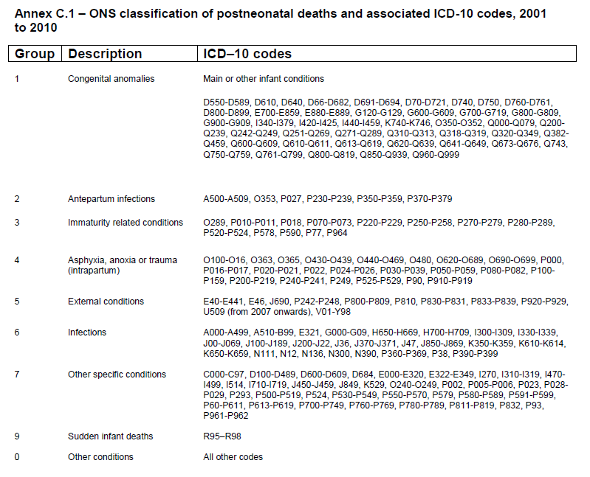
Infant deaths
Timing of damage
Before the onset of labour
In, or shortly after labour
Postnatal
Unclassified
Notes:
ONS has developed a hierarchical classification system producing broad cause groups to enable direct comparison of neonatal and postneonatal deaths. The hierarchical classification, which is referred to as the ONS
cause groups, allows the death to be assigned to a specific category, based on the likely timing of the damage leading to the death.

Slide 17
Main causes of infant death
ONS data for England & Wales, 2015
Neonatal deaths | % | n=1,809
Immaturity related conditions | 49.31 | 892
Congenital anomalies | 30.9 | 559
Antepartum infections | 7.85 | 142
Asphyxia, anoxia or trauma (intrapartum) | 7.41 | 134
Sudden infant deaths | 1.66 | 30
Other specific conditions | 1.11 | 20
Infections | 1.05 | 19
Other conditions, incl external | 0.72 | 13
Postneonatal deaths | % | n=722
Congenital anomalies | 41.41 | 299
Immaturity related conditions | 18.28 | 132
Sudden infant deaths | 18.28 | 132
Infections | 9.14 | 66
External conditions | 4.57 | 33
Other conditions | 4.29 | 31
Antepartum infections | 2.22 | 16
Other specific conditions | 1.52 | 11
Asphyxia, anoxia or trauma (intrapartum) | 0.28 | 2
Infant deaths | % | n=2531
Immaturity related conditions | 40.46 | 1024
Congenital anomalies | 33.90 | 858
Infections, including antepartum | 9.60 | 243
Sudden infant deaths | 6.40 | 162
Asphyxia, anoxia or trauma (intrapartum) | 5.37 | 136
All other conditions | 4.27 | 108
Notes:
Among neonatal deaths, conditions occurring before the onset of labour (immaturity related conditions, congenital anomalies and antepartum infections) and during labour caused over 95% (88.1% plus 7.4%) of deaths, while among postneonatal deaths these caused only 62%, with 2/3 (66.6%) caused by congenital anomalies.
For neonatal deaths, antepartum infections are much more frequent (88% based on the ONS 2015 data) when postpartum infections are much more frequent (80.5%) in postneonatal deaths
The distribution of causes of death differs between the Eng & W data and Italian data – reasons? ER and Tuscany cover an earlier period, may be classification differences, may be geographic differences

Slide 18
Main causes of infant death
ONS data for England & Wales, 2015
Emilia Romagna, 2009-2015 (ICD-10)
Infant deaths | % | n=2531
Immaturity related conditions | 40.46 | 1024
Congenital anomalies | 33.90 | 858
Infections | 9.60 | 243
Sudden infant deaths | 6.40 | 162
Asphyxia, anoxia or trauma (intrapartum) | 5.37 | 136
All other conditions | 4.27 | 108
Infant deaths | % | n=800
Immaturity related conditions | 36.8 | 294
Congenital anomalies | 25.9 | 207
All other conditions | 19.3 | 154
Asphyxia, anoxia or trauma (intrapartum) | 9.5 | 76
Infections, including antepartum | 7.1 | 57
Sudden infant deaths | 1.5 | 12
Tuscany, 1995-2015 (ICD-9/10)
Infant deaths | % | N=2,366
All other conditions | 43.7 | 1,033
Immaturity related conditions | 33.3 | 788
Congenital anomalies | 10.6 | 250
Asphyxia, anoxia or trauma (intrapartum) | 6.3 | 148
Infections, including antepartum | 3.9 | 94
Sudden infant deaths | 1.1 | 25
Missing | 1.2 | 28
Notes:
Among neonatal deaths, conditions occurring before the onset of labour (immaturity related conditions, congenital anomalies and antepartum infections) and during labour caused over 95% (88.1% plus 7.4%) of deaths, while among postneonatal deaths these caused only 62%, with 2/3 (66.6%) caused by congenital anomalies.
For neonatal deaths, antepartum infections are much more frequent (88% based on the ONS 2015 data) when postpartum infections are much more frequent (80.5%) in postneonatal deaths
The distribution of causes of death differs between the Eng & W data and Italian data – reasons? ER and Tuscany cover an earlier period, may be classification differences, may be geographic differences

Slide 19
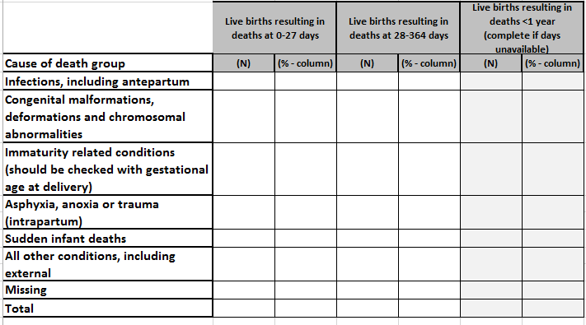
Table 4A - Cause of infant death
Notes:
Neonatal deaths:
Immaturity related conditions (check gestational age) – 892 (49.3%) – in about 2% (n=17) BW was above 2500g (in 11.8% BW was not stated), the vast majority (74%, n=662) had BW <1000g.
Postneonatal deaths:
Immaturity related conditions – 132 (18.3%) – none had BW >2500g, 20% (1/5) had unknown BW, about 70% (n=92) had BW <1000g.
All other conditions, including external and unspecified/unclassified - are we interested in separating unspecified conditions to have an idea about how many were not classified?

Slide 20
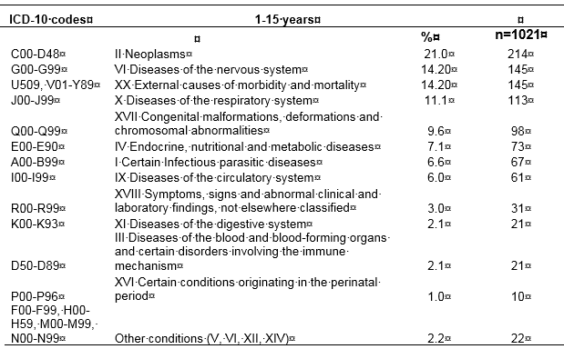
Main causes of death at age 1-15 years,
ONS data for England & Wales, 2015
90%

Slide 21
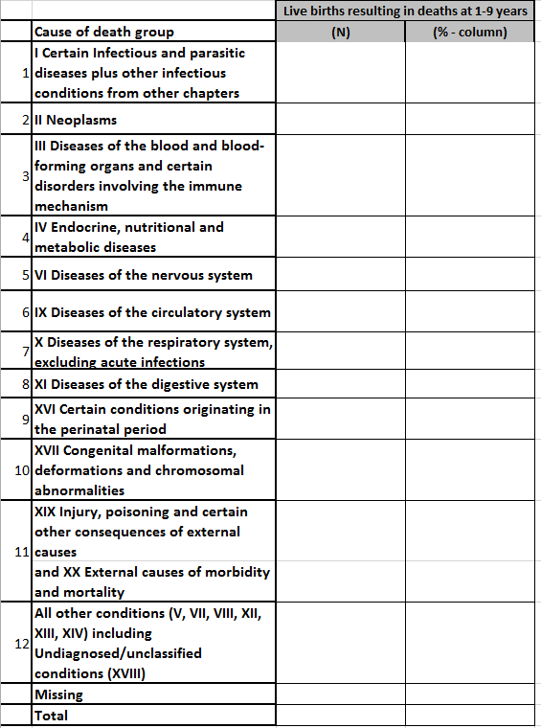
Table 4B - Cause of death (1-9 years)

Slide 22
Analysis of the geographic variation (1)
Aim
to investigate whether there are geographic variations in survival across Europe for selected EUROCAT congenital anomalies subgroups.
Geographic variation will be evaluated by the estimates produced at registry level using the following approaches:
The between-registry heterogeneity (through the I² statistic) produced for the pooled estimate in the meta-analysis will be considered. Risk indicators (crude and adjusted) calculated by each registry will be used (Tables T 6A – T 6G).
Evaluate the variability of TOTAL mortality given the observed mortality in children with congenital anomalies; collect general information on mortality (e.g. neonatal) (Tables T 7A – T 7B).
Use information on risk factors for specific anomalies investigated to interpret the geographic variations (Tables T 8A – T 8C).
Notes:
Aim
to investigate whether there are geographic variations in survival across Europe for selected EUROCAT congenital anomalies subgroups.
1) the results of the K-M survival analysis and Cox regression produced at registry level will be used and the between-registry heterogeneity will be calculated;
2) general information on mortality (including fetal and neonatal) will be used for the interpretation of the variation in mortality associated with congenital anomalies;
3) Use information on risk factors for the specific anomalies to interpret the geographic variations.

Slide 23
Analysis of the geographic variation (2)
T 7A-T 8C spreadsheets
T 7A - Resident populations and deaths in the background registry population, by year of death and age at death
T 7B - Neonatal and fetal deaths in the background population by year
T 8A – Risk factors distribution and adjusted survival estimates at 7, 28 and 365 days (1 risk factor at a time) - Four subgroups of isolated congenital anomaly (spina bifida, transposition of great arteries, diaphragmatic hernia and gastroschisis)
T 8B - Risk factors distribution and adjusted survival estimates at 1 and 10 years (1 risk factor at a time) - isolated structural anomalies (A, R, N, I)
T 8C - Risk factors distribution and adjusted survival estimates at 1 and 10 years (1 risk factor at a time) - Down Syndrome
Notes:
Data from five spreadsheets will be used:
T 7A and B - resident populations and deaths (including fetal and neonatal) by year of death and age at death
T 8A-C - Risk factors distribution and adjusted survival estimates for different age groups and types of congenital anomalies.

Slide 24
Analysis of the geographic variation (3)
Additional and supplementary analyses will be performed:
a. Pooled estimates of the European areas (i.e. Northern, Western, Eastern, Southern) will be calculated by using the estimates calculated at registry level. The heterogeneity among estimates of the registries belonging to the same European area will be assessed through the I² statistic.
b. Specific statistical exploratory techniques can be used to identify latent information among the results produced:
- cluster analysis to identify 3-4 groups of registries according to survival indicators related to all anomalies and subgroups. Results can give insights into registry similarities.
- group registries by defining 3-4 geographic areas a priori; then random forest to characterize the areas in terms of survival indicators related to all anomalies and subgroups.
Notes:
This slides describes additional and supplementary analyses that are proposed to be performed, for example,
a) calculation of pooled estimates of the European areas (i.e. Northern, Western, Eastern, Southern) using the registry-based estimates;
b) some specific statistical exploratory techniques, e.g. cluster analysis or random forest.

Slide 25
Next steps
Obtaining Ethics approvals and other permissions for WP3
Linkage between the EUROCAT congenital anomaly data and mortality data
Assessment of the linkage quality and quality of the linked data
Writing registry-specific syntax scripts
Meeting with local statisticians at QMUL in October in relation to syntax scripts issues
Running local analyses for WP3 using the syntax scripts
WP3 Systematic review
Notes:
Obtaining Ethics approvals and other permissions for WP3
Linkage between the EUROCAT congenital anomaly data and mortality data
Assessment of the linkage quality and quality of the linked data
Writing registry-specific syntax scripts
Meeting with local statisticians at QMUL in October in relation to syntax scripts issues
Running local analyses for WP3 using the syntax scripts
WP3 Systematic review

Slide 26
Timeline for WP3
2017
2018
2019
2020
2021
Gantt Chart | Year 1 |  |  |  | Year 2 |  |  |  | Year 3 |  |  |  | Year 4 |  |  |  | Year 5
 | Q1 | Q2 | Q3 | Q4 | Q1 | Q2 | Q3 | Q4 | Q1 | Q2 | Q3 | Q4 | Q1 | Q2 | Q3 | Q4 | Q1 | Q2 | Q3 | Q4
WP3: Mortality associated with Congenital Anomalies
Develop protocols for registry ethical approval
Develop protocols for analysis
Analysis and writing of 2 peer review papers
Dissemination

Slide 27
Ethics submission in 21 registries
Congenital Anomaly Registry | Data linked but permission for data access needed | Ethics/other permissions submitted | Ethics approval granted | Other approvals granted | Issues delaying the linkage | Estimated linkage time/receipt of linked data
Belgium: Antwerp |  | ✓ | ✓ (Antwerp Uni) | Not yet (Privacy commission) |  | No exact time yet
Croatia: Zagreb |  | ✓ | ✓ | Not needed | ✓ (identifiers) | delayed
Denmark: Odense | ✓ | ✓ | Not needed | Awaiting – Stats Denmark | No | June
Finland | ✓ | ✓ (after the WP5 protocol finalised) | Not needed | Not yet |  | No exact time yet
France: Ile de la Reunion |  | ✓ | Not yet |  | ✓ | No exact time yet
France: Paris |  | ✓ | ✓ |  | ✓ (identifiers) | No exact time yet
Germany: Saxony-Anhalt |  | ✓ | Not yet |  | ✓ | No exact time yet
Italy: Emilia Romagna |  | ✓ | ✓ |  | No | Ongoing
Italy: Tuscany |  | ✓ | ✓ |  | No | Ongoing
Malta |  | ✓ | ✓ |  | No | Started in May
Netherlands: Northern |  | ✓ | Not needed | ✓ | No | June
Norway | ✓ | ✓ | Not needed | ✓
Spain: Basque |  | ✓ | ✓ |  | No | June
Spain: Valencia |  | ✓ | ✓ |  | No | Started in May
UK East Midlands |  | ✓ | ✓ | GDPR – ongoing | No | No exact time yet
UK: North |  | ✓ | ✓ | GDPR – ongoing | No | No exact time yet
UK: South West |  | ✓ | ✓ | GDPR – ongoing | No | No exact time yet
UK: Thames Valley |  | ✓ | ✓ | GDPR – ongoing | No | No exact time yet
UK: Wales |  | ✓ | ✓ | Not needed | No | Started in May
UK: Wessex |  | ✓ | ✓ | GDPR – ongoing | No | No exact time yet
Ukraine: West |  | ✓ | ✓ | Not needed | No | Started in May
Notes:
This table gives a snapshot of the progress with Ethics approvals (or other permissions) and data linkage for 21 WP3 participants.
Depending on the local situation, all registries submitted either their applications for Ethics approval for data linkage or other permissions (e.g. to access linked data - Finland, Denmark and Norway).
10 registries have already obtained permissions (e.g. BINOCAR received REC and CARG approvals) for data linkage and 6 have started the data linkage (Italy: ER, Italy: Tuscany, Malta, Spain: Valencia, Wales, Ukraine), other registries are awaiting other permissions (e.g. BINOCAR - GDPR, Denmark – Statistics Denmark, Antwerp – Privacy commission) and among them, three (Denmark, NNL, Spain, Basque) estimated to start it in June.
GDPR=General Data Protection Regulation form to establish legal/lawful basis for processing with the data linkage and document/publish it

