Slide 1
Making Sense of Data …
… experiences of working at QMUL
Dr. med. A. Rißmann
Malformation Monitoring Centre Saxony-Anhalt
Germany
EUROlinkCAT Meeting 12th June 2018

Slide 2
Erasmus+ Staff Training Mobility: for Academic + Administrative Staff
The mobility activities are expected to produce the following outcomes:
… increased motivation and satisfaction in their daily work.

Slide 3
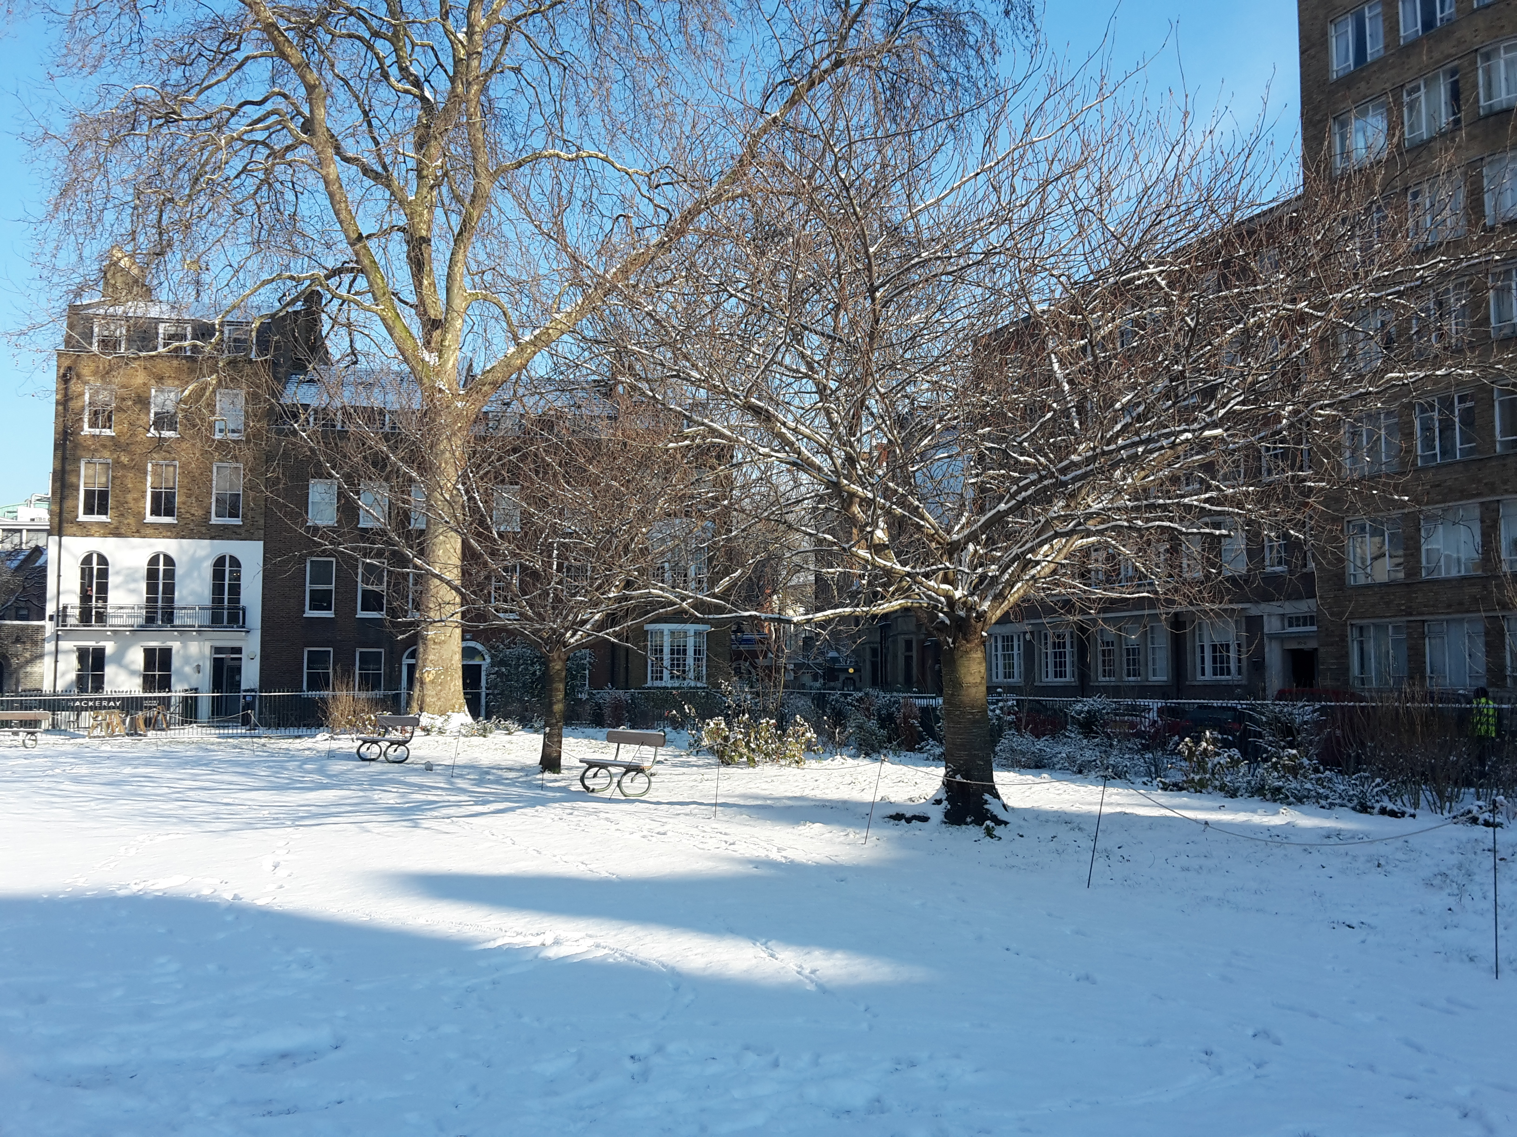
Queen Mary University of London - Charterhouse Square Campus, Wolfson Institute Of Preventive Medicine
https://www.zazzle.ch/danke_fur_ihre_gastfreundschaft_karte-137005885257661405
www.londonist.com

Slide 4
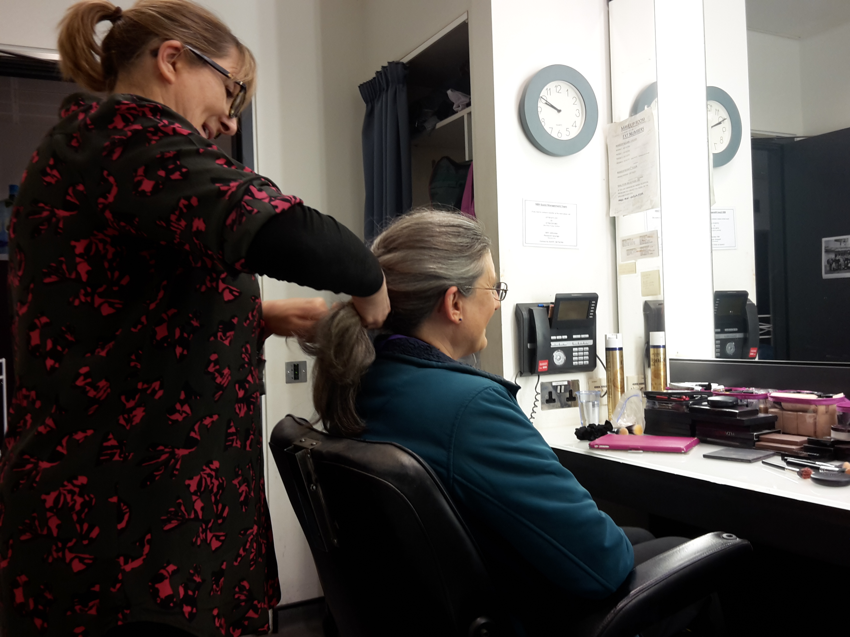

Slide 7
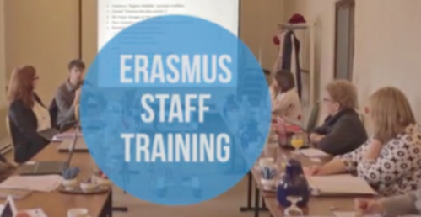
Erasmus+ Staff Training Mobility: for Academic + Administrative Staff
The mobility activities are expected to produce the following outcomes:
improved competences, linked to professional profiles
broader understanding of practices, policies and systems in education, training or youth across countries;
increased capacity to trigger changes in terms of modernisation and international opening within their educational organisations;
greater understanding of interconnections between formal and non-formal education, vocational training and the labour market respectively;
better quality of their work and activities in favour of students, trainees, apprentices, pupils, adult learners, young people and volunteers;
greater understanding and responsiveness to social, linguistic and cultural diversity;
increased ability to address the needs of the disadvantaged;
increased support for and promotion of mobility activities for learners;
increased opportunities for professional and career development;
improved foreign language competences;
… increased motivation and satisfaction in their daily work.

Slide 9
Pre-requisites of participation:
The sending and receiving organisations, together with the staff, must have agreed on the activities to be undertaken by staff members - in a 'Mobility Agreement' - prior to the start of the mobility period. These agreements define the target learning outcomes for the learning period abroad, specify the formal recognition provisions and list the rights and obligations of each party.
Venue of the activity:
Staff must carry out their mobility activity in any Program Country different from the country of the sending organisations and the staff country of residence. The Erasmus+ Program Countries are the following:
Austria, Belgium, Bulgaria, Czech Republic, Croatia, Cyprus, Denmark, Estonia, Finland, France, Germany, Greece, Italy, Ireland, Latvia, Lithuania, Luxembourg, Malta, Netherlands, Poland, Portugal, Romania, Slovakia, Slovenia, Spain, Sweden, United Kingdom, former Yugoslav Republic of Macedonia, Iceland, Norway, Liechtenstein, Turkey

Slide 10
The receiving organisation must be:
a Program Country Higher Education Institution awarded with an ECHE,
any Program Country public or private organisation active in the labour market or in the fields of education, training and youth:
any public or private organisation active in the labour market or in the fields of education, training and youth. For example, such organisation can be:
a public or private, a small, medium or large enterprise (including social enterprises);
a public body at local, regional or national level;
a social partner or other representative of working life, including chambers of commerce, craft/professional associations and trade unions;
a research institute;
a foundation;
a school/institute/educational centre (at any level, from pre-school to upper secondary education, and including vocational education and adult education);
a non-profit organisation, association, NGO;
a body providing career guidance, professional counselling and information services;

Slide 11
Eligible activities abroad:
Job shadowing
Seminars
Workshops
Courses
Practical training
Study visits
Conferences are excluded.
www.staffmobility.eu/
Duration of the mobility:
The minimum duration for an Erasmus+ Staff Training Mobility is 2 working days and CEU provides grant for a maximum of 5-6 days. The staff training mobility must be carried out between 1 August 2018 and 30 September 2019.
Financial rules:
Selected applicants are eligible to receive funds to partially support their visit, which does not cover all the actual expenses incurred. Funds eligible for Erasmus+ Staff Training Mobility are made up of two components; Individual Support (Subsistence) and Travel Contribution.

Slide 12
Sir Prof. Nicholas Wald, FMedSci FRS (Former Director, Wolfson Institute of Preventive Medicine)

Slide 13
http://blog.wenzlaff.de/?tag=danke

